Slide 1
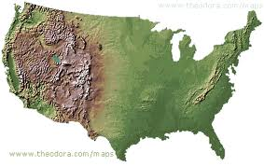
Westward Expansion

Slide 2
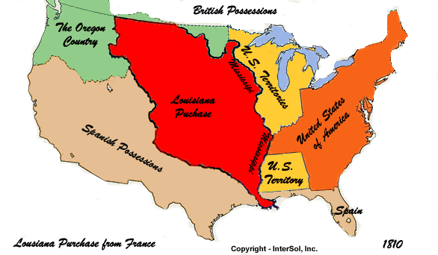
Louisiana Purchase
When: 1803
The Americans purchased land from the French.
This purchase doubled the size of the United States.

Slide 3
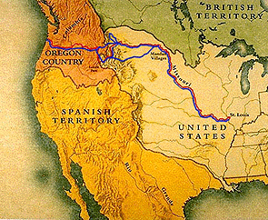
Lewis and Clark Expedition
Date: 1804
President Jefferson sent them to explore the land.
Three goals:
1. Gather information about the land
2. Study the western Indians’ culture
3. Explore the Missouri and Columbia rivers
They met these goals and kept journals with details.

Slide 4
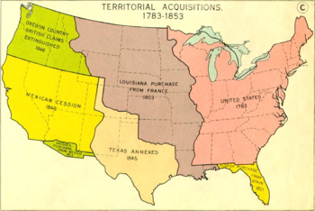
Texas Alamo
Date: 1848
Americans did not like the laws made by Mexican government.
America wanted the border with Mexico to be the Rio Grande River.
After a short war with Mexico a treaty was signed giving the United States nearly all of the present day Southwest.

Slide 5
California Gold Rush
Date: 1849
Miners called forty-niners rushed to California because gold was discovered.
These people came from all over the world.
Lasted only five years, but many people stuck around.

Slide 6
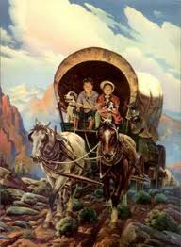
Oregon Trail
Date: 1850’s
Path for covered wagons to the west.
People were looking for good and inexpensive land.
Problems: injuries, disease, bad weather, and lack of food and water.

Slide 7
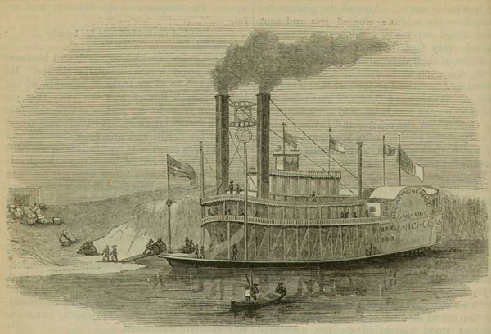
Impact of Steamboat
Date: 1807
The first boat that did not need oars, wind, or water current to move.
Roads were bad. Much trade was done by boats and canals.
The steamboat helped trade and many more canals were built.

Slide 8
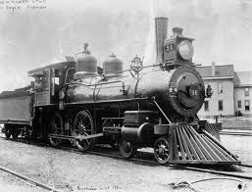
Impact of Steam Locomotive
Date: 1805
New tracks covered 9,000 miles.
A trip from New York City to Albany, New York took 32 hours by steamboat, but only 10 hours by train.

Slide 9
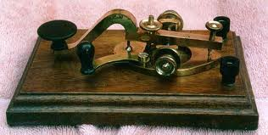
Impact of Telegraph
Date: 1831
Tele- means “far away”
This electric telegraph sent messages from long distances.
How did this help people communicate?

